Slide 1
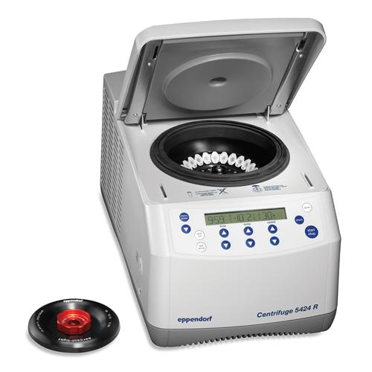
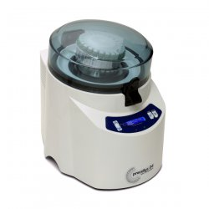
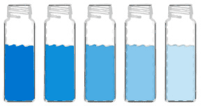

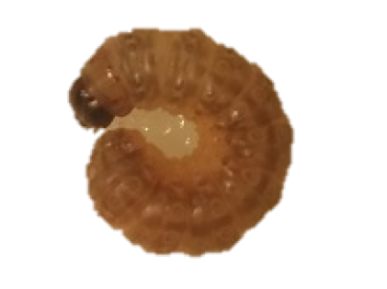
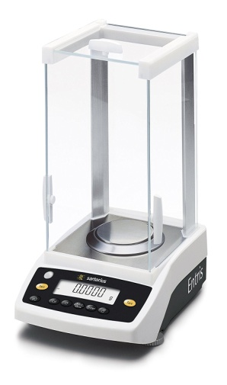
Data Collected
-Total lipid mass
-Triglyceride concentration
-Triglyceride composition
Notes:
Quantification
HPLC-ELSD to quantify TAG in larval samples
Identification
GC-FID to identify methylated TAG samples

